Slide 1
San Francisco Sheriff’s Department FY2023-24 & FY2024-25 Budget
February 13,2023

Slide 3
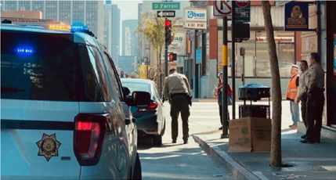
Protect San Francisco
Improving Public Safety
Work with our criminal justice partners, community organizations and members to improve the quality of life in San Francisco
Field Training Officers
Expand Warrant Services Unit
Reduce retail theft crime
Victim Services
Cameo House

Slide 4
Protect San Francisco: Improving Outcomes
Peer advocacy - Meet people at the time of release for linkage
Provide more robust Discharge Planning Services for those persons most frequently booked
Implement a new program to address opioid addiction at the time of booking
Enhance communication with providers through use of tablets (direct messaging)
Safe Passage transport, Safe Harbor beds and coordinated entry for DHSH
Increase case managers for ACM at SF Pretrial
Free Phone Calls: Cost for 15-minute call from $4.45 FY14 to $0.00 FY21. Funding for free phone calls included in FY22-23 & FY23-24 base budget.

Slide 5
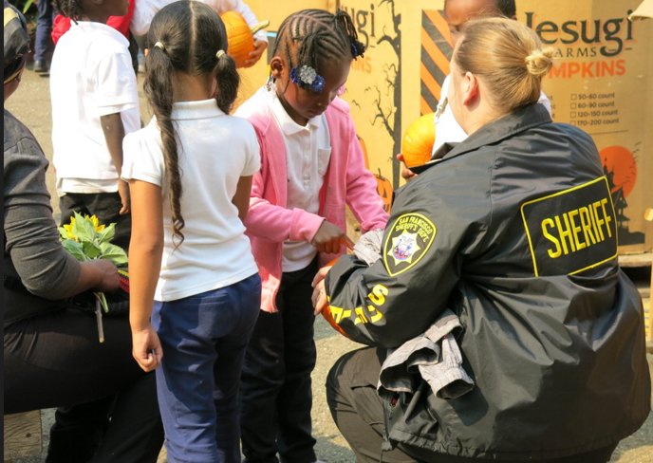
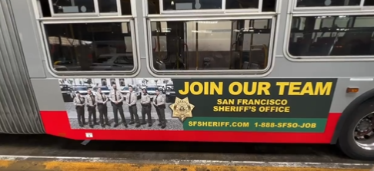
Engage San Francisco
Expand Youth Programs
Retention: Ensure staff can successfully meet expectations
New ask: 500K in funding to address recruitment

Slide 6
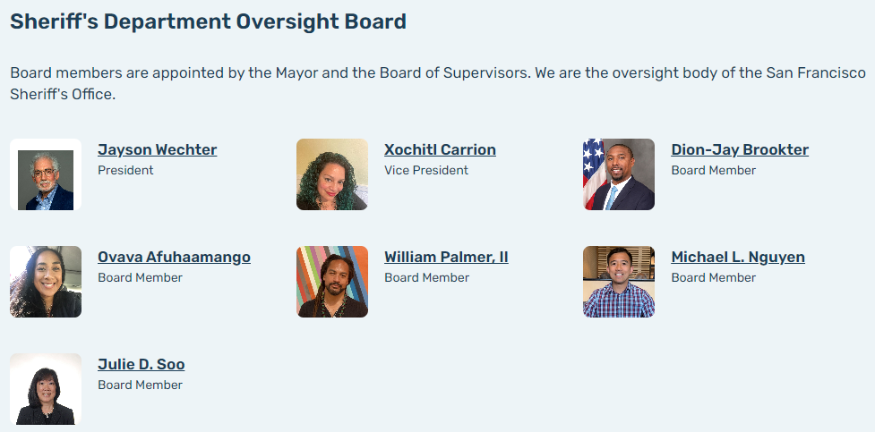
Improve Organizational Accountability
Increase out of cell time
Chicago Beyond
Holistic Safety
Expand OIS board to include use of force review
SB 2 Reporting
Oversight Board
Employee Wellness:
Implement an employee wellness program
Improve the physical environment for staff and offer opportunities for expansion
San Francisco Sheriff’s Oversight Board Members

Slide 7
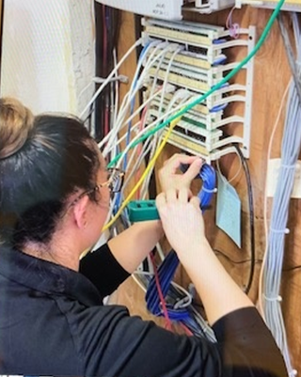
Modernize Technology
Modernize Data: Support transparency and unfunded mandates
Replace Jail Management System to be more flexible and provide more responsive data
3 professional staff: 1043 System Engineer: 1824 Analyst: 1093
Additional staff for a broader expansion of BWC and subsequent review and disclosure of recorded data as legally permissible
3 – 8173 Classification Legal Assistant
1 – 8508 Sheriff’s Sergeant

Slide 8
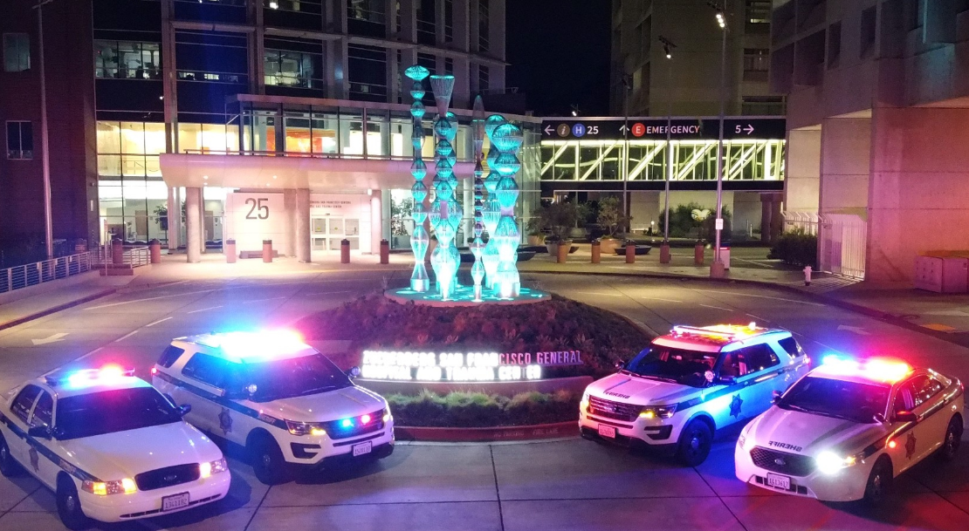
Maximize Workforce Potential
Improve the work-environment for staff:
) Jails
Re-allocating / updating of space
Modernize workstations
New equipment
Chicago Beyond
) Reduce injuries
Safety committees
) Increase Pride
New vehicles
Equipment

Slide 9
Hiring Not Keeping Pace with Separations
Sworn Staff Hiring vs. Sworn Attrition

Slide 10
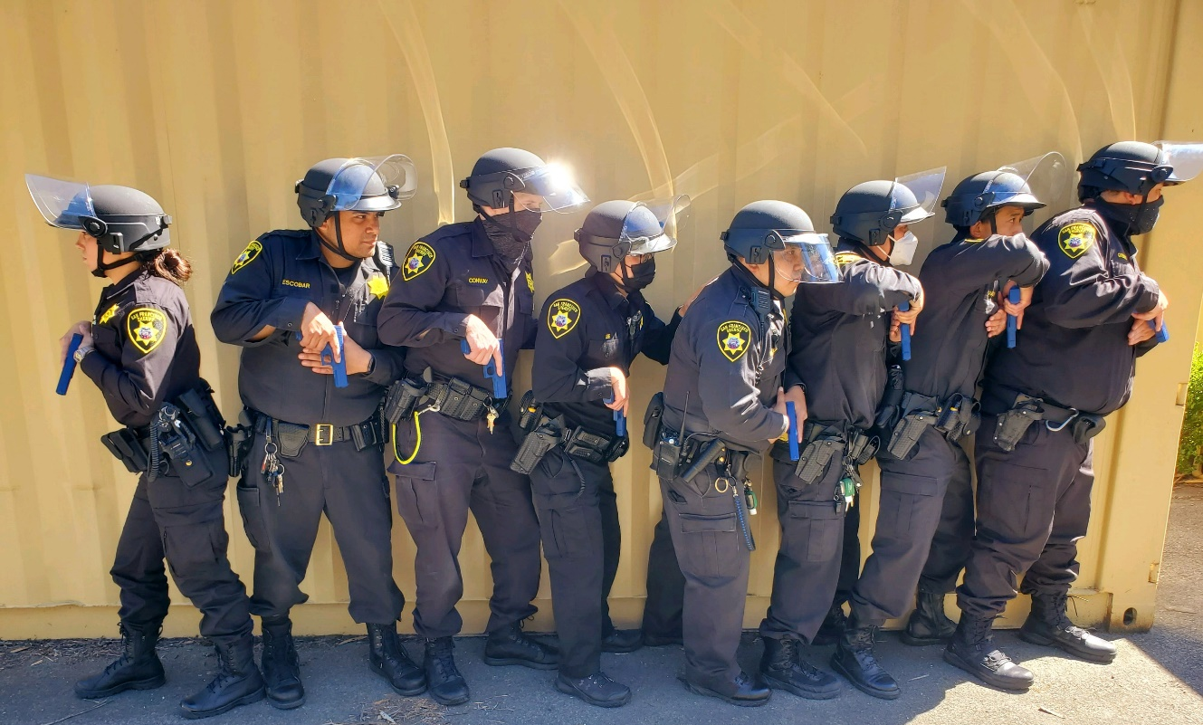
Enrich Training
Invest In and Value our Employees
Ensure staff can successfully meet expected supervisor training, FTO, Active Shooter, Emergency Services Unit, Special Response Team, POST leadership training and command college, Crisis Intervention Techniques, and training for professional staff.

Slide 11
Mayor’s Office Requested Cuts
Mayor’s Office General Fund FY2021-22: ≈$244,665,234
5% - $10,277,497
Working to meet the requested budget cuts while enhancing safety for the community, our staff and the incarcerated population

